Slide 1

Perforce Plugin for Jenkins
An introduction to the ‘P4’ Plugin and update
on the latest features.
Paul Allen – Perforce Software

Slide 2

Paul Allen
Senior Integration Engineer
Perforce

Slide 3
Introduction
The Perfect Monorepo
P4 plugin
Credentials
Workspace management
Perforce Operations
Polling, triggers and reviews
P4 Groovy
Notes:
What makes the perfect monorepo
The P4 Plugin
…

Slide 4
The Perfect Monorepo
What is a Monorepo?

Slide 5

One Repo
One Repo to rule them all, One Repo to find them,
One Repo to bring them all and in the server bind them.

Slide 6

One Store
Store all sources, projects and sub projects;
even artifacts, tooling, docs and test reports...
Notes:
No storage limits
Any size any type, users with Petabytes of data

Slide 7

One History
Boldly go across source and time
Reproduce any source at any point in time
Notes:
Cross project Mapping, map any file from any repo in your view.
Global sequential identifier
Global change number across all repos; sequential so you know what happened when

Slide 8

Global Access
Any file any where
Fast Global Distribution
Fine grain protections
Notes:
Global distribution
Distributed replicas (edge/commit) and build servers, not to forget proxies (some sites proxies per-switch per-floor)
Fine grain protection
Any level, from none to fully encrypted traffic. Access level as fine as you like even down to the individual file and restricted to user/group IP even proxy.
Distributed Client
Little known fact that we have DVCS support built in. Take any portion of the server and its history off-line and push you changes back later.

Slide 9
P4 Plugin
Perforce plugin support for Jenkins

Slide 10
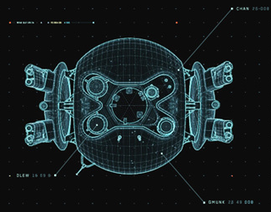
Disambiguation
Community ‘Perforce’ plugin
  https://wiki.jenkins-ci.org/display/JENKINS/Perforce+Plugin
Perforce Supported ‘P4’ plugin
  https://wiki.jenkins-ci.org/display/JENKINS/P4+Plugin

Slide 11
The ‘P4’ plugin
Why
  Access the power of Perforce from within Jenkins
P4Java
  Pure Java solution
  No ‘P4’ executable to install and keep up-to-date.
Latest features
  Streams, sync and clean up options
Notes:
The P4 plugin was designed to allow you to access all the power of the Perforce MonoRepo.
Allowing Jenkins to fetch source and artifacts from Perforce and version the resulting build artifacts

Slide 12
Credentials
Connecting to Perforce…

Slide 13
Credentials
Perforce Credentials
  Shared Credentials
  Managed from one location
  Independent from the Job configuration
  Update connection details in one location
Credential Types
  Perforce Password Credential
  Perforce Ticket Credential

Slide 14
Credentials
Connection information
  Username/Password
  Perforce address and port
  workshop.perforce.com:1666
Password credentials
  Username
  Password
  ID (useful to reference in the DSL)
  Description

Slide 15
Credentials
Ticket based security
  Perforce generated Ticket String
  $ p4 login –p
  4E034A8812F81B38229BF8FA62B0FEB1
  Location of Perforce P4TICKET file
  /home/pallen/.p4ticket
SSL and Trust
  Check the SSL box to add the ssl: part to P4PORT
  Use p4 trust or click test to get the fingerprint

Slide 16
Workspace Management
Jenkins and Perforce Workspaces
Notes:
20minutes here

Slide 17
Workspaces
Jenkins workspace
  Location of files (on the master or slave) for Jenkins to build
Perforce workspace
  Location where Perforce will manage the versioned an non-versioned files
Shared root
  Recommend Perforce and Jenkins workspaces share the same root
  One Jenkins workspace to map to one Perforce workspace

Slide 18
Workspaces
Workspace Configuration
  Streams Workspace
  Manual Workspace
  Template Workspace
  Static Workspace (predefined)
  Spec Workspace (spec depot or file)
  workspace: [$class: 'StreamWorkspaceImpl',
  charset: 'none',
  format: 'jenkins-${NODE_NAME}-${JOB_NAME}',
  pinHost: false,
  streamName: '//streams/st1-main']

Slide 19
Workspace
View Mapping
  +---AceProject
  | +---src
  | +---test
  | +---docs
  | +---libs
  +---BlastProject
  | +---src
  | +---test
  | +---docs
  | +---libs
  | | +---blast.jar
  //depot/AceProject/...
  -//depot/AceProject/docs/...
  -//depot/AceProject/libs/...
  //depot/BlastProject/libs/...

Slide 20
Workspace
  //depot/AceProject/...
  -//depot/AceProject/docs/...
  -//depot/AceProject/libs/...
  //depot/BlastProject/libs/...
  //{client}/Ace/...
  -//{client}/Ace/docs/...
  -//(client}/Ace/libs/...
  //{client}/Ace/plugins/...

Slide 21
Workspace
Perforce Depot
  +---AceProject
  | +---src
  | +---test
  | +---docs
  | +---libs
  +---BlastProject
  | +---src
  | +---test
  | +---docs
  | +---libs
  | | +---blast.jar
Jenkins Workspace
  +---Ace
  | +---src
  | +---test
  | |
  | |
  | +---plugins
  | | |
  | | |
  | | |
  | | |
  | | +---blast.jar

Slide 22
Streams
Virtual Streams to manage files
Configured outside of Jenkins
Check the Generated Mapping
Notes:
share - appears in the workspace and you can submit and integrate to the parent
isolate - appears in the workspace and you can submit, isolated from parent
import - appears in the workspace only, cannot submit changes (import+)
exclude - will not appear in the workspace, cannot get submitted

Slide 23
Variable expansion
Built in Variables
  /env-vars.html
Perforce Variables
  P4_CHANGELIST P4_CLIENT
  P4_PORT P4_USER
  P4_TICKET
Workspace
  Name jenkins-${NODE_NAME}-${JOB_NAME}
  View //depot/… //jenkins-${NODE_NAME}-${JOB_NAME}/…

Slide 24
Perforce Operations
Checkout, Build and Post Build Steps

Slide 25
CD Pipe
SCM Operations
CI Build pipeline
populate
@review
@change
@label
Artifact
{"id":[{"name":"bob"}]}
unshelve
package main
import "fmt”
func main() {
publish
SCM
Label
label

Slide 26
SCM Operations
Populate p4sync / checkout
  Synchronize the files in the Workspace prior to build.
Unshelve p4unshelve
  Unshelve code into the Workspace prior to build.
Publish p4publish
  Submit files back into Perforce, post build.
Label p4tag
  Automatic label against the populated files in the Workspace, post build.

Slide 27
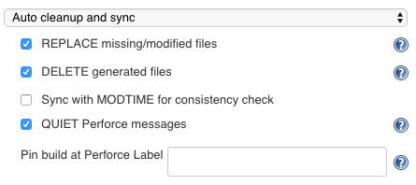
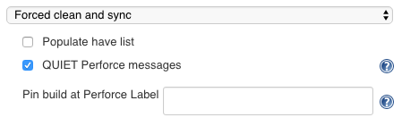
Populate
Auto Cleanup and Sync
  populate:[$class:'AutoCleanImpl',
  delete:true, replace:true, modtime:false,
  quiet:true, pin:''
  ]
Force Clean and Sync
  populate: [$class: 'ForceCleanImpl',
  have:false, pin:'', quiet:true
  ]
Notes:
Preview Check Only – sync -k to trigger polling
Sync Only – no cleanup

Slide 28
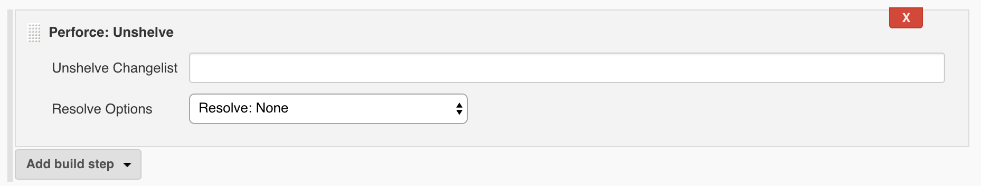
Unshelve
Unshelve Build Step
  Unshelve the change as a Build step defined in the Job
  Files are unshelved and resolved prior build.
  p4unshelve resolve:'at', shelf:'12345'

Slide 29
Publish
Shelve or Submit a change
Connection & Workspace
Use a narrow view
Virtual stream
Read/Write access for files
  Set Workspace option ALLWRITE or use filetype +w

Slide 30
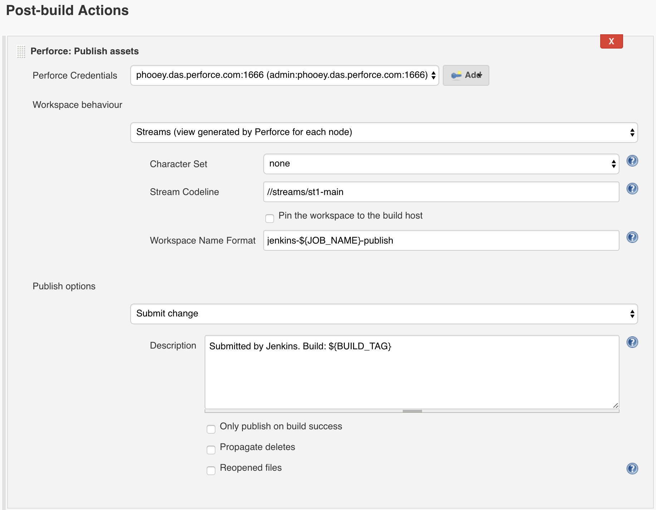
Publish
p4publish credential:'phooey1666',
publish: [
$class:'SubmitImpl',
delete:false,
description:'Build: ${BUILD_TAG}',
onlyOnSuccess:false,
reopen:false],
workspace: [
$class:'StreamWorkspaceImpl',
charset:'none',
format:'jenkins-${JOB_NAME}-publish',
pinHost:false,
streamName:'//streams/st1-main']

Slide 31
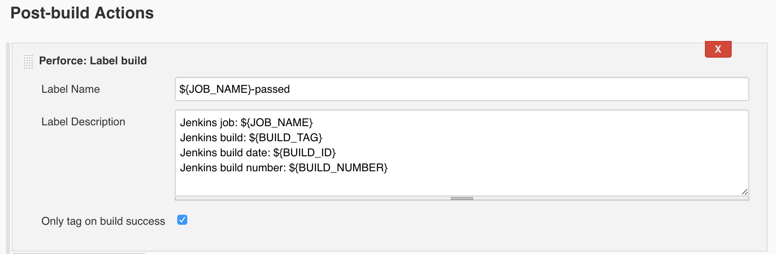
Label
Automatic label
  Label on success option
  Uses Populate Client’s View
Name & Description
  p4tag rawLabelName:'${JOB_NAME}-passed',
  rawLabelDesc:'''Jenkins job: ${JOB_NAME}
  Jenkins build: ${BUILD_TAG}
  Jenkins build date: ${BUILD_ID}
  Jenkins build number: ${BUILD_NUMBER}'''

Slide 32
Polling, Triggers and Reviews
Still polling?

Slide 33
Polling… if you must
Polling build Filters
  Exclude changes from Depot path
  Exclude changes from user
  Exclude changes outside view mask
  Poll on Master using Latest Build
  Polling per Change
Workspace modes
  Workspace to check the build - Preview check Only (sync –k)

Slide 34
Triggers
Perforce triggered build
Subscribe Job (P4 Trigger)
  curl --header 'Content-Type: application/json' \
  --request POST \
  --data "payload={change:200,p4port:\"perforce.com:1666\"}" \
  http://jenkins:8080/p4/change
Swarm (P4 Review)
  Build triggered by Perforce Swarm.
  Review or Change unshelved into workspace prior to build

Slide 35
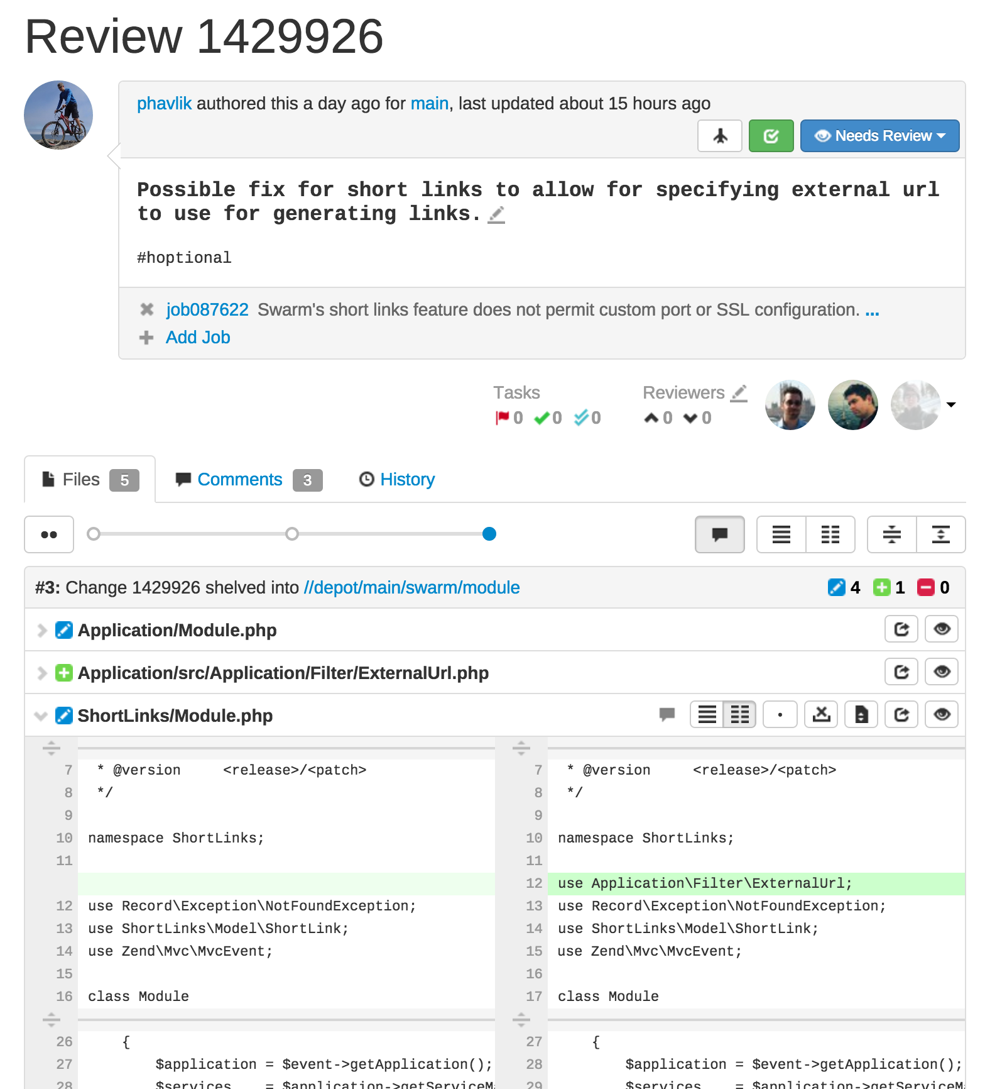
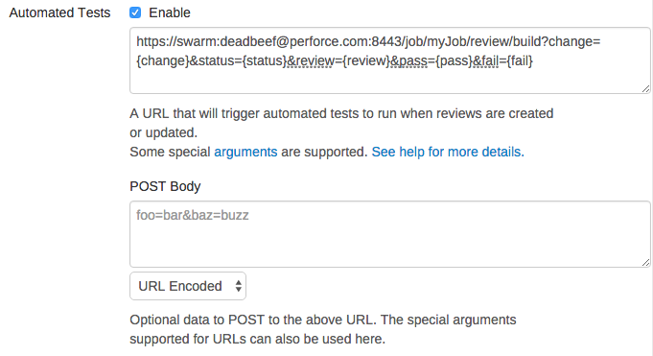
Swarm
  [POST]
  https://swarm:deadbeef@perforce.com:8443
  /job/myJob/review/build
  ?change={change}&status={status}&review={review}
  &pass={pass}&fail={fail}

Slide 36
P4 Groovy
P4 command access for Groovy

Slide 37
P4Groovy
P4Groovy object
  Credential
  Workspace
  ws = [$class: 'StreamWorkspaceImpl',
  charset: 'none', format: 'jenkins-${JOB_NAME}',
  pinHost: false, streamName: '//streams/projAce']
  p4 = p4(credential: 'phooey', workspace: ws)

Slide 38
P4Groovy Methods
Run
  Requires: command, arguments (‘,’ separated String)
  Returns: tagged output (specifically Map<String, Object>[])
  p4.run(’changes', '-m5, //...')
Getters
  p4.getUserName()
  p4.getClientName()

Slide 39
P4Groovy Methods
Fetch
  Requires: spec type, spec id
  Returns: a spec as a Map
  client = p4.fetch(‘client’, ‘my_ws’)
Save
  Requires: spec type, the spec as a Map
  Returns: tagged output (specifically Map<String, Object>[])
  p4.save(‘client’, client)

Slide 40
Example
Combine Steps with P4Groovy
  Populate is made up of several steps not just sync
  Use P4Groove for custom operations e.g.
  node() {
  ...
  job = p4.fetch('job', 'job000006')
  desc = job.get('Description')
  desc = desc + env.BUILD_URL
  job.put('Description', desc)
  p4.save('job', job)
  }

Slide 41
Thanks for Joining us!

