Slide 1
Hive Helix Artifact Manager
Paul Allen Senior Integration Engineer
Sven Erik Knop Technical Marketing Manager

Slide 2
Artifact manager?
Common artifact managers
Sonatype Nexus
Artifactory
Nuget (Windows specific)
Apache Archiva

Slide 3
What is an Artifact?
‘... one of many kinds of tangible by-products produced during the development of software.’
Wikipedia: Artifact (software development)
Typically generated through a build process
Intermediary artifacts such as Java jar files or DLLs
Containers or Executables
Metadata describes details such as version or build time

Slide 4
Lifecycle of an Artifact
Build processes
Consume artifacts
Generate (intermediate) artifacts
Produce (deployable) artifacts
CI Build pipeline
1010110011100111
SCM
Artifact
1010110011100111

Slide 5
What does an Artifact Manager do?
Storage of artifacts with their Metadata
Distribution through standardized access
Management

Slide 6
Why Hive?
We have an artifact storage – it is called Helix!
Storage, Security, Replication ...
Needs common interfaces
Accessibility for consumers
Browse, search and deploy
Management for setup, permission and cleanup

Slide 7
Hive
Stores and makes accessible your artifacts
Prototype of an Artifact Manager built on Helix
Lives in the workshop
Nectar for your bees, hence the name

Slide 8
Here comes the Science bit…
Over to Paul

Slide 9
What is Hive?
Browse
Plugin Framework
Maven
Generic
Search
Docker
Hive
Docker
User
Functions
Deploy
Vagrant
Helix P4D
Notes:
A RESTful API for each artifact type, currently:
Generic
Maven
Docker (under development)
Gem (under development)
Web Management tool

Slide 10
Generic Artifacts
Basic Curl for retrieval and deployment
curl -o p4java.jar http://localhost:4567/view/test/p4java.jar
curl -u admin:Password --upload-file \
p4java.jar \
http://localhost:4567/view/test/p4java.jar

Slide 11
Maven API
…or perhaps more useful, Maven:
mvn package
mvn deploy:deploy-file
-DgroupId=com.perforce
-DartifactId=p4java
-Dversion=2015.1.1067177
-DrepositoryId=hive
-Durl=http://localhost:4567/view/test
-Dfile=p4java-2015.1.1067177.jar

Slide 12
Hive Pipeline
CI Build pipeline
1010110011100111
1010110011100111
SCM
Artifact

Slide 13
Hive Pipeline
CI Build pipeline
1010110011100111
1010110011100111
SCM
Artifact
Maven
Docker
Hive

Slide 14
Helix backed Storage
Helix Depots
Backed by one or more ‘local’ depot for each type.
For example:
3 different Maven depots.
Plugin Framework
Maven
//
//
//
Generic
//
//
Docker
//
Vagrant
//

Slide 15
Depot Types
Storage
Internal repository for company generated artifacts
Proxy
Cached copy of artifacts from a remote repository
Group
Collection of repositories: Storage, Proxy and other Groups
Query order determined by group

Slide 16
JSON Magic
Uses the Depot Description field for metadata
Depot: mvn-central
Type: local
Description:
Json: {
"url":"http://repo1.maven.org/maven2/",
"name":"mvn-central",
"title":"Maven Central Proxy",
"site":"PROXY",
"type":"MAVEN",
"description":"Proxy for Maven Central"
}

Slide 17
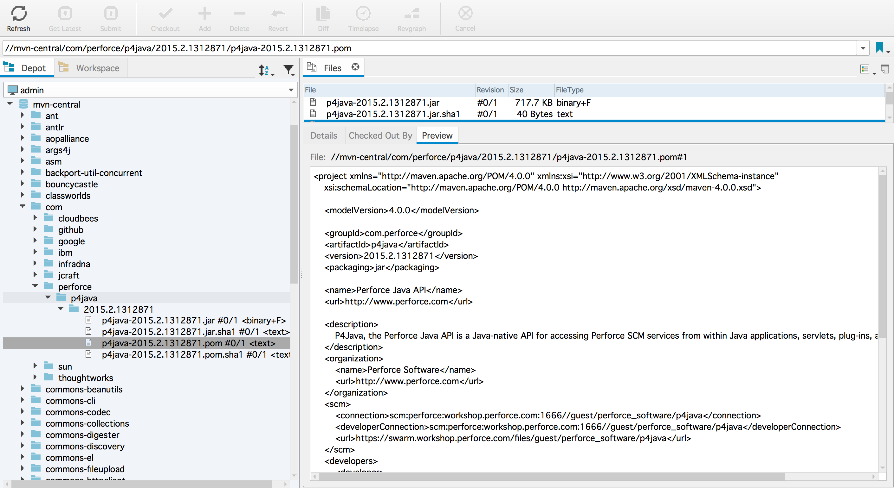
File Storage
Accessible by all our clients
Path matches the artifact
No custom formats
All the features of Helix
Proxy
Replication technologies

Slide 18
Deployment
Helix P4D
Users
Hive

Slide 19
Distribution
Replica
Helix P4D
Proxy

Slide 20
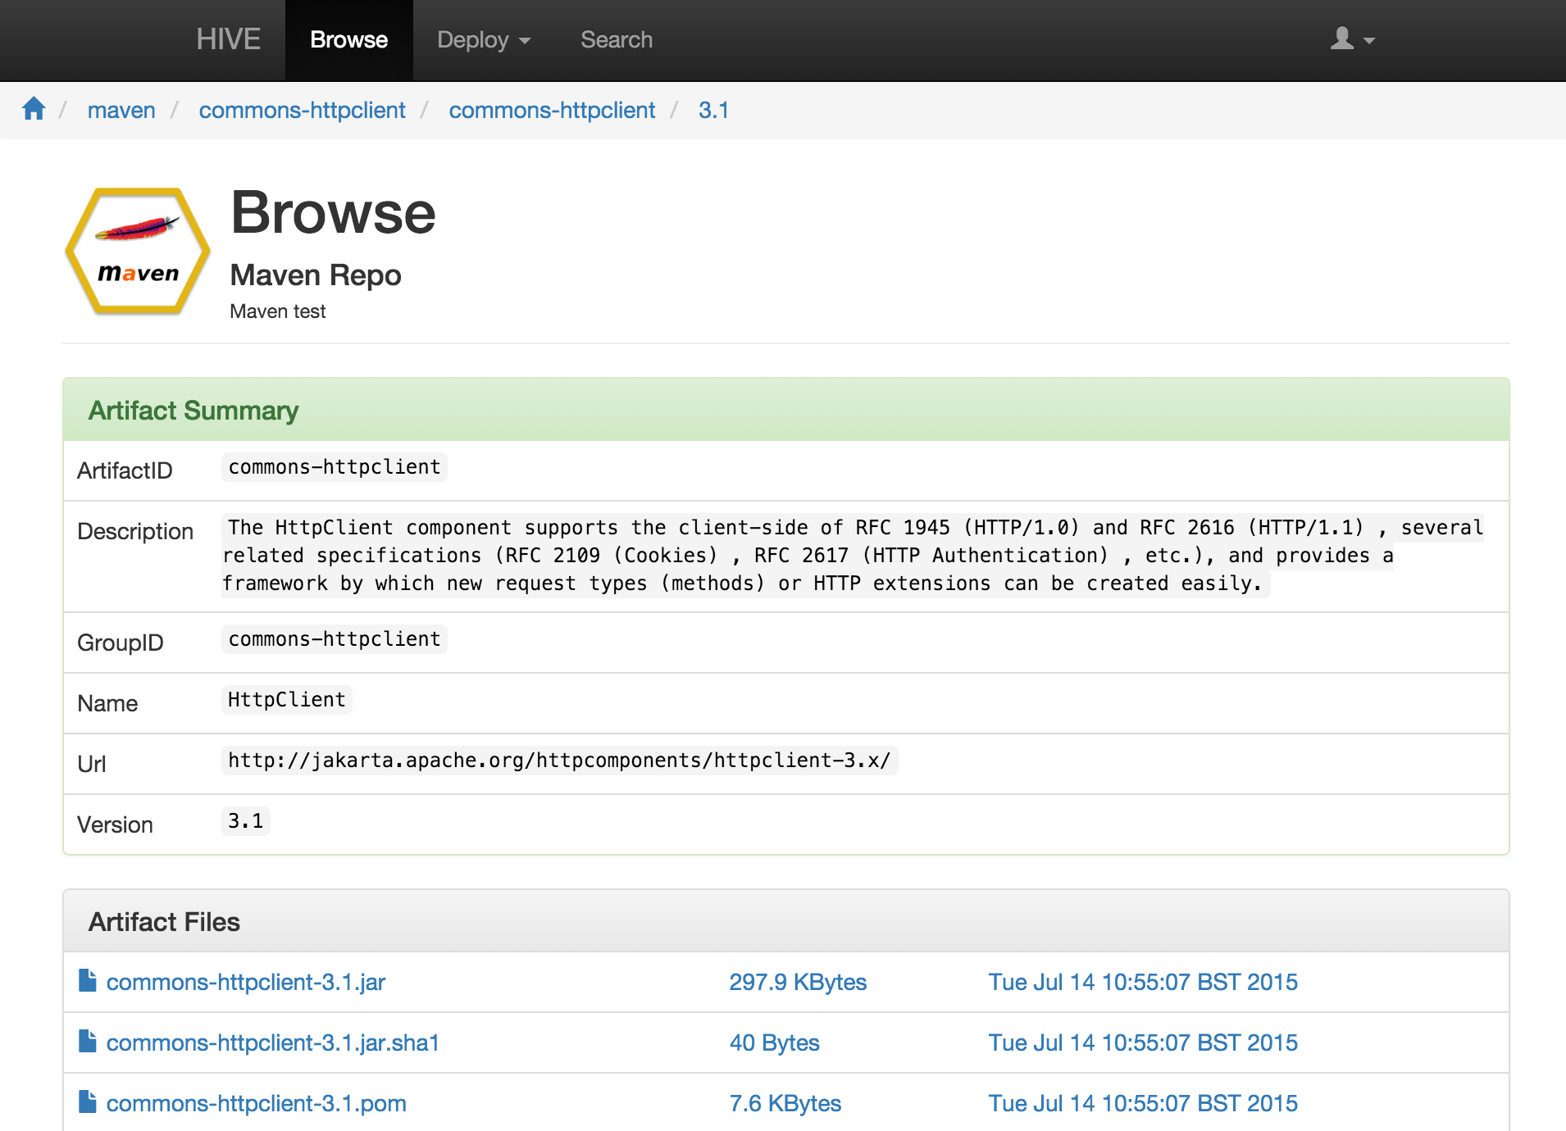
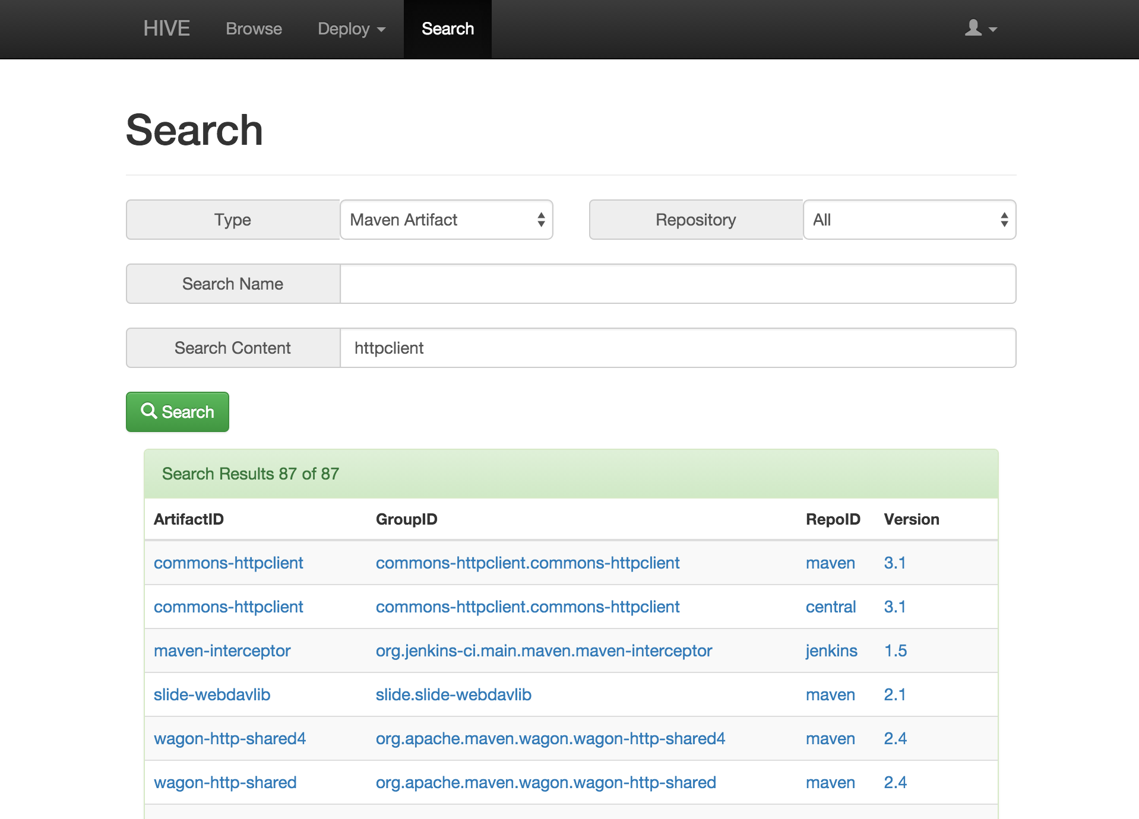
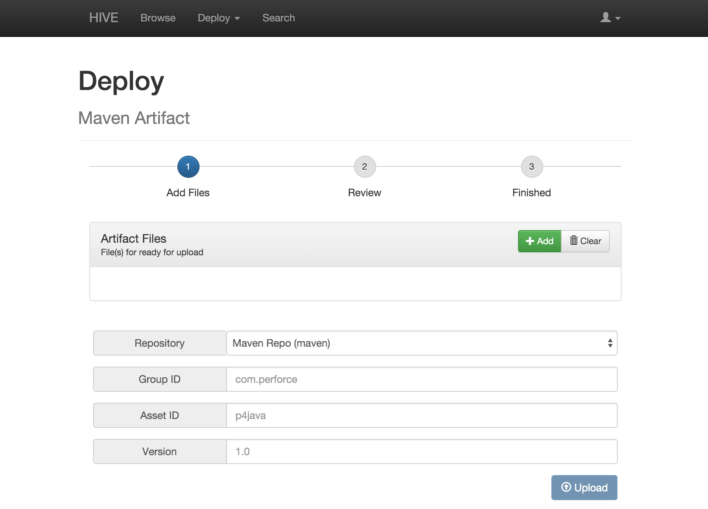
Web Management
Browse
Search
Deploy

Slide 21
User Administration
In addition to regular Perforce users
anonymous
Grant access to artifact depots for users without a login
hive
Grant access to artifact depots for Hive to cache files

Slide 22
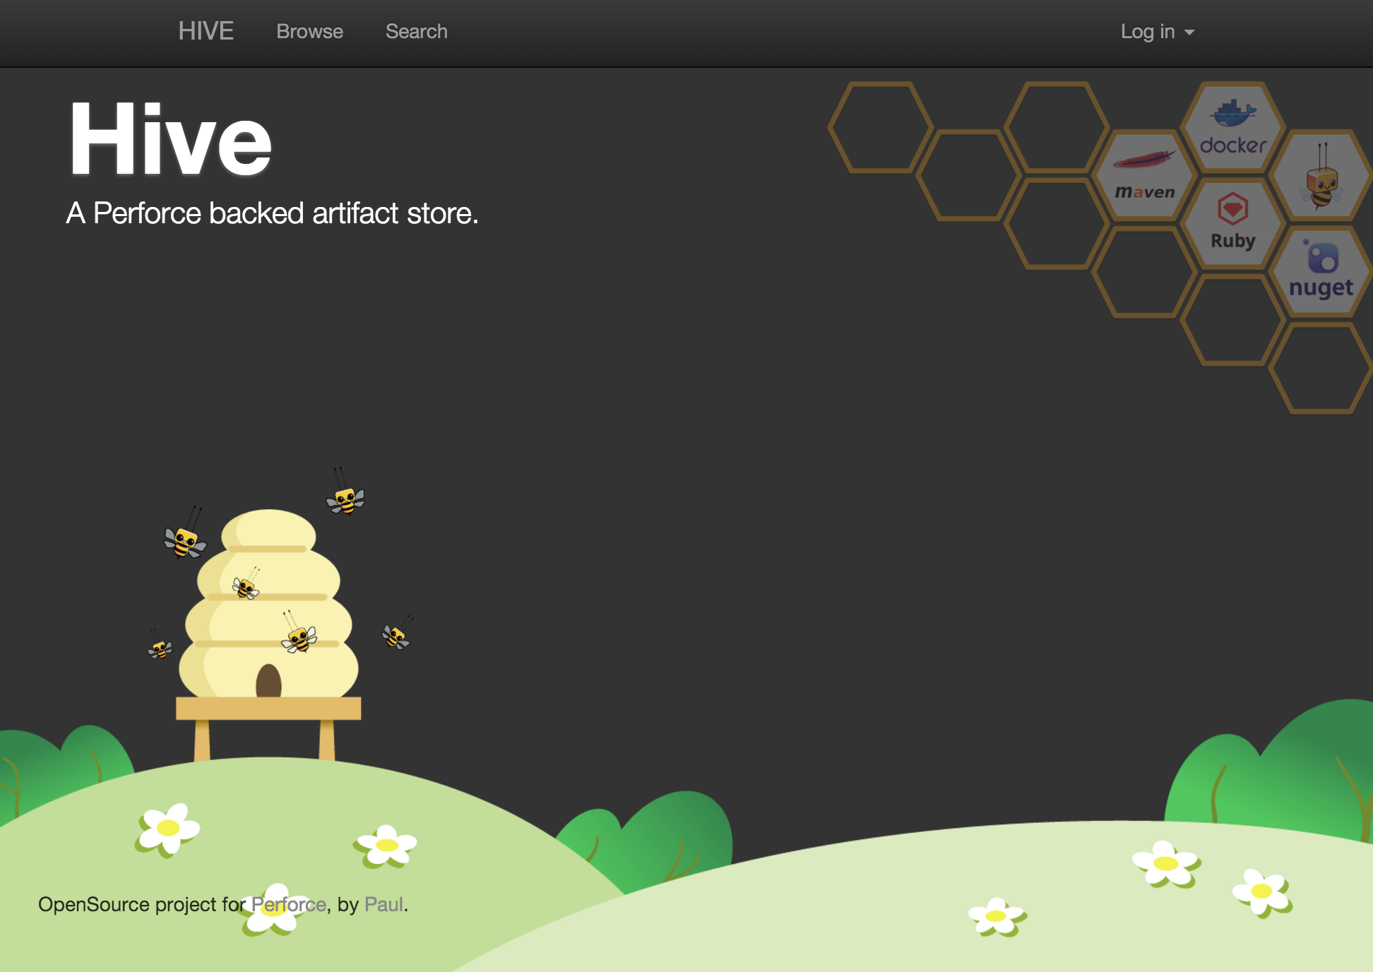
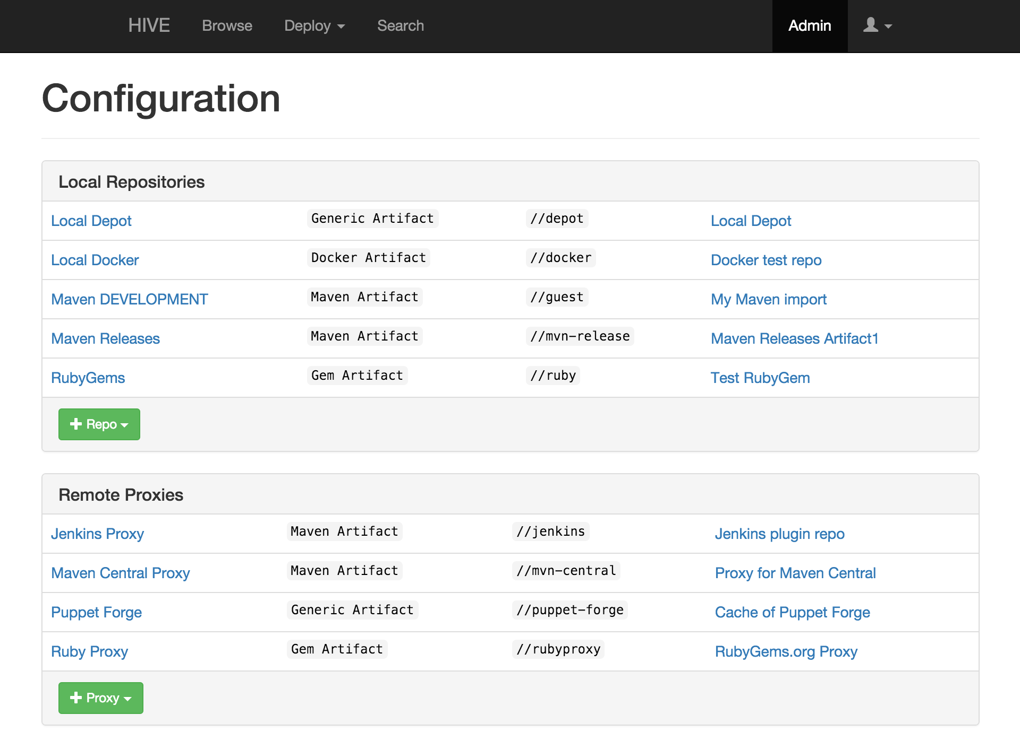
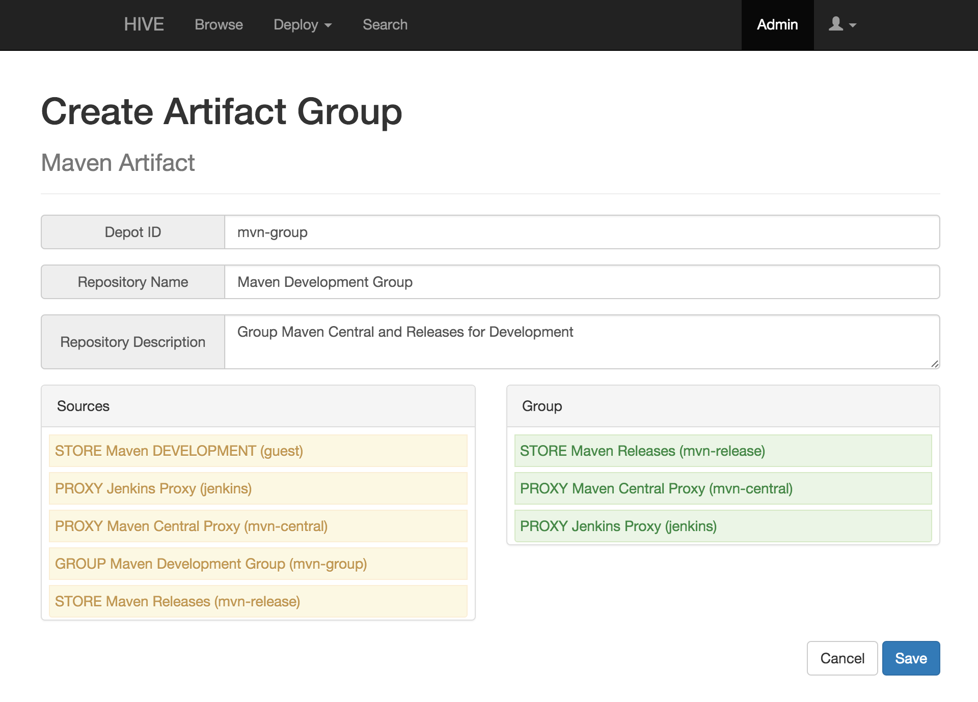
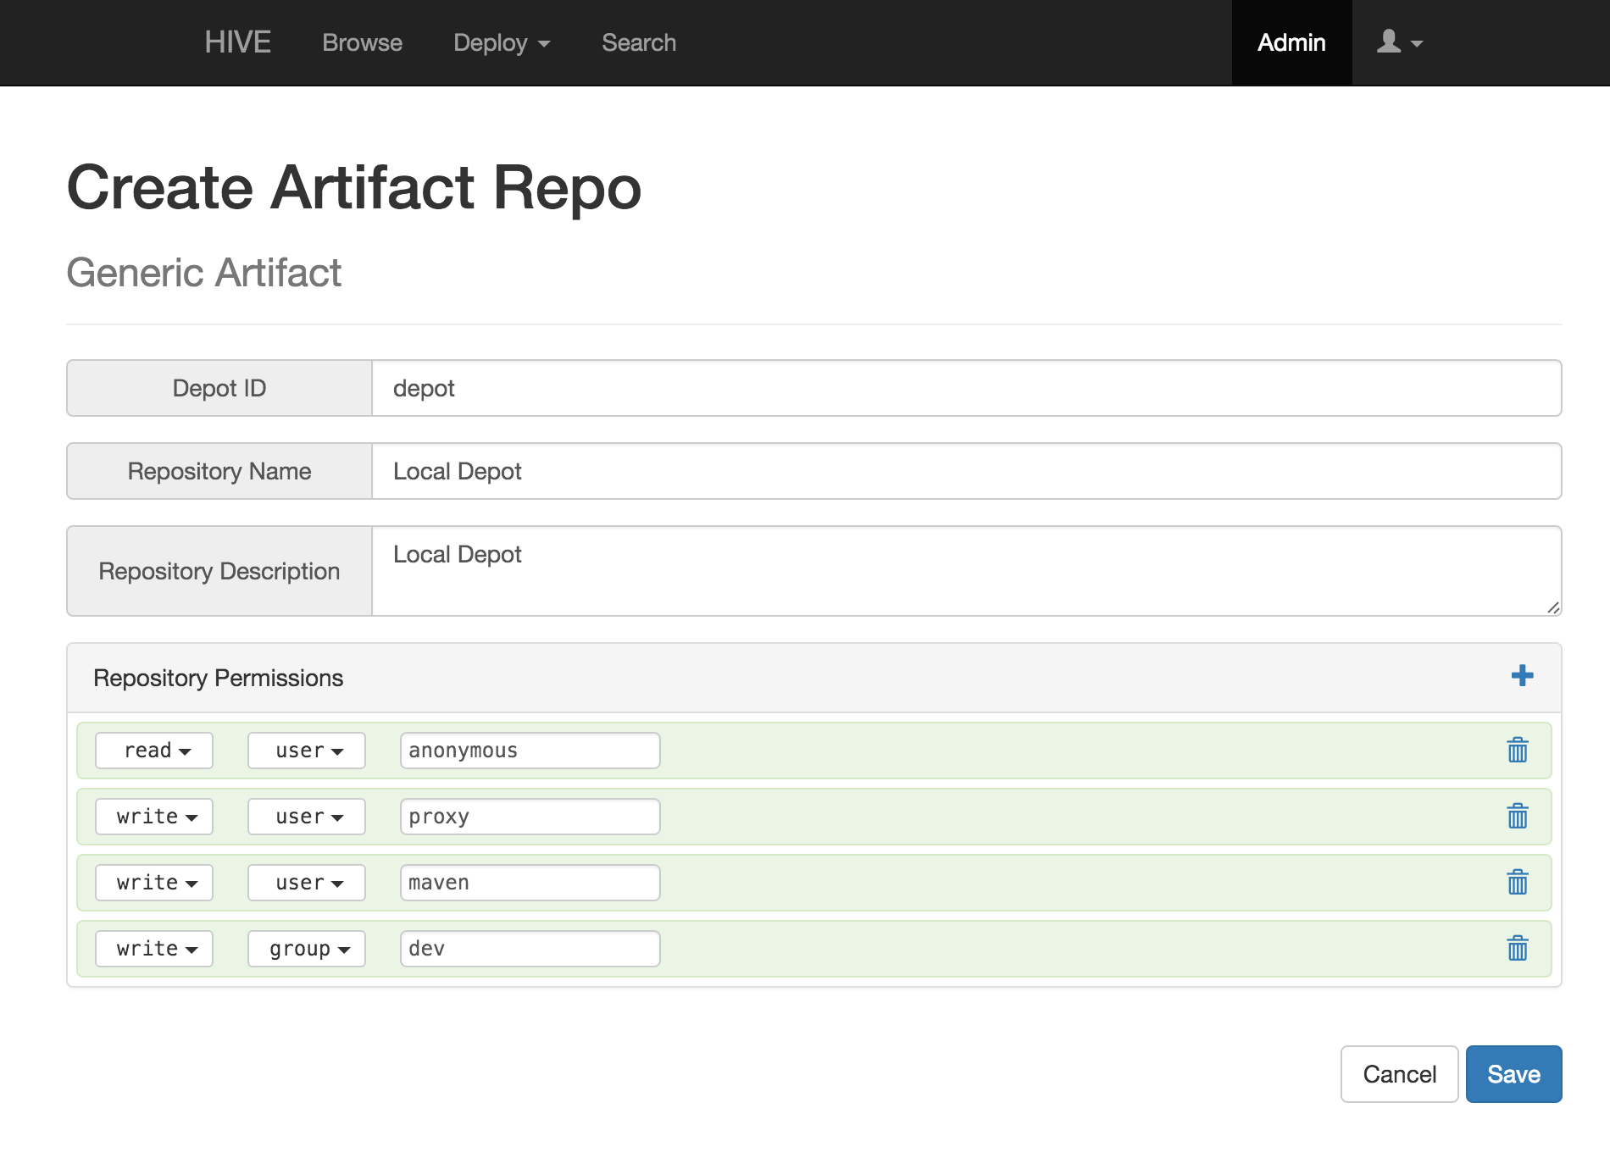
Web Administration
Secure login
Manage Repos
Map Groups
Permissions
Obliterate

Slide 23
Demo
Browse anonymously
Login and Browse
Search for Content
Deploy an artifact

Slide 24
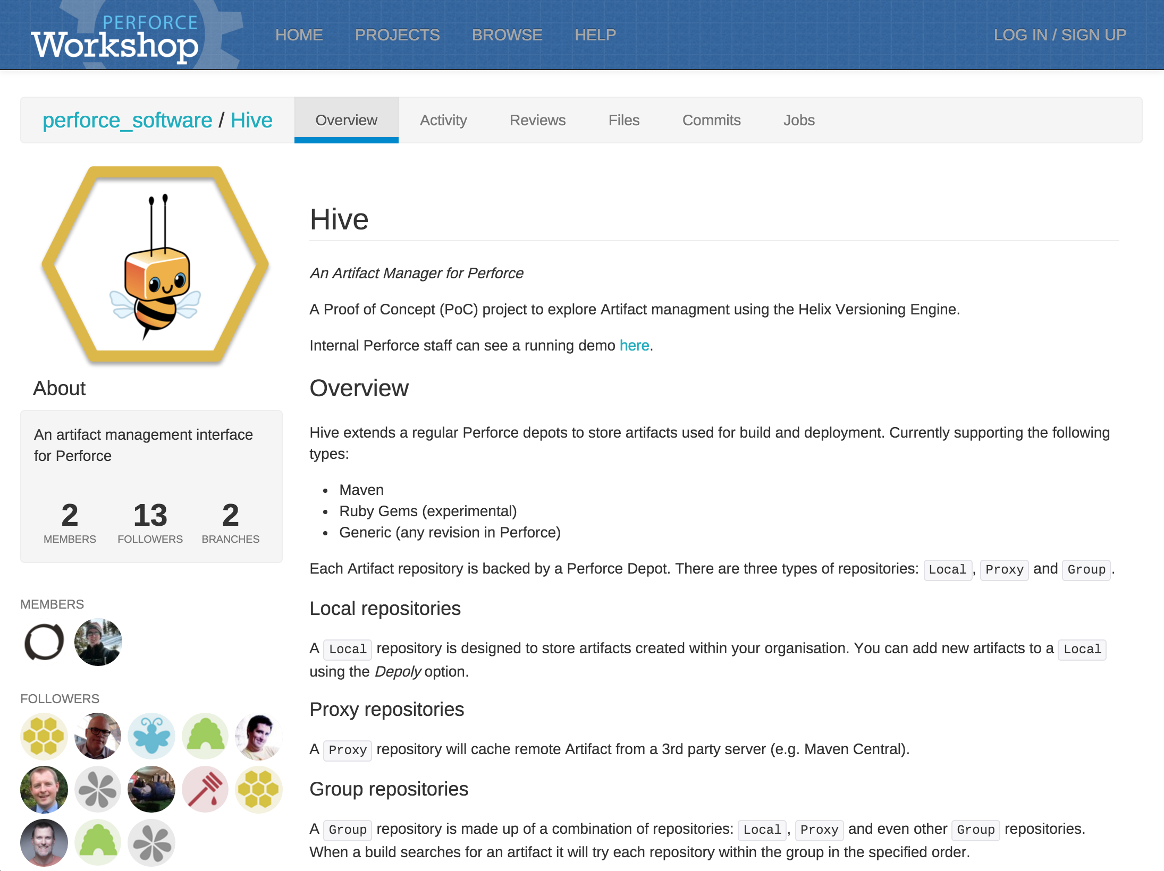
Follow Hive in the Workshop
Help develop plugins
Suggest improvements
Follow the activity

Slide 25
Thank you!
pallen@perforce.com
sknop@perforce.com
@p4paul
@p4sven

