Slide 1

Perforce Directory Standard (PDS)
Doc Id: PDS-Diagrams.pptx, v5.2 (October 18, 2013). Copyright © 2008-2013, Perforce Software, Inc.

Slide 2
PDS Characteristics
Shared Global namespace within the enterprise
Common elements conveyed by directory structure (non-streams) or stream model:
  Product Family or Business Unit Name
  Product Name
  Streams, conveying lifecycle info
  Branch Container Directories
Even if Perforce deployment is initially small, presume it will permeate the enterprise when defining a PDS.
Notes:
Stream model includes parent-child relationship and stream names.

Slide 3
PDS Classic Components
Product Family & Product
Levels
Permanent Streams & Branch Containers
Low Level Dirs
/live
/svcs
/custom
/src
/test
//ProductFamily
/main
/rel
/Product
/etc
/doc
/latest
/int
Typically one or two “organization” directory levels per depot, e.g. Product Family, Business Unit, etc.
/dev
These are samples only. Low level directory structure is outside the scope of an PDS.
/Maj.min-[P|R|D|I]
/exp
/demo
/sb
(sandbox)

Slide 4
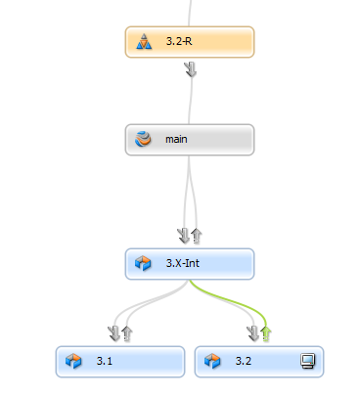
PDS Streams Components
Product Level – Stream Depot
/Product
Permanent Streams & Branch Containers
- Stream names
/live
/main
/rel-*
Low Level Dirs
/src
/doc
/test

Slide 5
PDS Branching Patterns
A relatively small set of best practice branching patterns
result from a wide variety of development environments.
Some Common Branching Patterns:
Basic Maintenance
Advanced Maintenance
Patch Maintenance
Organic Development
Basic Planned Development
Advanced Planned Development
Customization
Basic Hosted
Standard Hosted
Standard Hosted with Emergency Bug Fix (EBF)
Notes:
Trim To Fit! It is not necessary to discuss or apply all branching patterns. When customizing this for a particular enterprise, branching patterns that don’t apply can be trimmed from this document. For large enterprises, it may be better to simply hide the slides for those that don’t apply for initial teams to which the PDS is rolled out, so they can be more easily restored in the event they are useful as the PDS expand within the enterprise.

Slide 6
Branch Pattern Combinations
svcs/Customer/main
rel/2.0.01-P
rel/2.0.02-P
svcs/Customer/latest
rel/2.0.03-P
rel/2.0-R
rel/2.0-D
/main
dev/VS2K8
dev/FGS218
dev/64Bit
Organic Development + Basic Maintenance
Organic Development + Advanced Maintenance
Organic Development + Patch Maintenance
Organic Development + Basic Maintenance + Customization
Organic Development
Basic Planned Development + Basic Maintenance
Notes:
Key Idea: Branching patterns can be combined to form a suitable branching strategy for a given software product or product line.
When presenting this slide, avoid going into detail about all the different patterns – do that on subsequent slides. The purpose of this slide is to get across the idea that branching patterns are combined in various ways to form a branching strategy.
Discuss the left-to-right flow of the diagram and the TOFU Scale, and introduce (but don’t yet discuss) the mantra, “Merge Down, Copy Up” (akin to pull before push in Git).

Slide 7
Branch Patterns &
Classic Directory Structures
rel/2.0-R
//fgs/rel/2.0-R/src/…
//fgs/main/src/…
//fgs/dev/VS2K8/src/…
//fgs/dev/64Bit/src/…
//fgs/dev/FGS218/src/…
/main
dev/FGS218
dev/VS2K8
dev/64Bit
Organic Development + Basic Maintenance
Organic Development + Advanced Maintenance
Organic Development + Patch Maintenance
Organic Development + Basic Maintenance + Customization
Organic Development
Basic Planned Development + Basic Maintenance
Notes:
Key Idea: A well designed directory structure should intuitively convey answers to questions like, “What type of changes should be made in this directory?”

Slide 8
Branch Patterns &
Streams Directory Structures
2.0-R
//fgs/2.0-R/src/…
//fgs/main/src/…
//fgs/VS2K8/src/…
//fgs/64Bit/src/…
//fgs/FGS218/src/…
main
FGS218
VS2K8
64Bit
Organic Development + Basic Maintenance
Organic Development + Advanced Maintenance
Organic Development + Patch Maintenance
Organic Development + Basic Maintenance + Customization
Organic Development
Basic Planned Development + Basic Maintenance
Notes:
Key Idea: A well designed directory structure should intuitively convey answers to questions like, “What type of changes should be made in this directory?”

Slide 9
PDS Animated Samples
On animated slides, the Smiley Face in the lower right corner appears to indicate
when animations are done.
Notes:
Equivalent stream diagrams are shown after the Static PDS Samples slide.

Slide 10
Organic Development
To Do for 3.1:
New Feature 304: Add ‘Goodbye’ messages.
Deprecate Windows-specific API calls in favor of universal API calls.
Support XML-style config file input.
Add HTML output format.
Add call to test driver stubs in makefile.
To Do for 3.1:
New Feature 304: Add ‘Goodbye’ messages.
Deprecate Windows-specific API calls in favor of universal API calls.
Support XML-style config file input.
Add HTML output format.
Add call to test driver stubs in makefile.
To Do for 3.1:
New Feature 304: Add ‘Goodbye’ messages.
Deprecate Windows-specific API calls in favor of universal API calls.
Support XML-style config file input.
Add HTML output format.
Add call to test driver stubs in makefile.
To Do for 3.1:
New Feature 304: Add ‘Goodbye’ messages.
Deprecate Windows-specific API calls in favor of universal API calls.
Support XML-style config file input.
Add HTML output format.
Add call to test driver stubs in makefile.
//fgs/main/src/main.c#7
//fgs/main/src/hello.c#4
//fgs/main/src/makefile#18
//fgs/main/src/api/hello.h#4
//fgs/main/etc/greetings.cfg#4
//fgs/main/etc/skins.cfg#124
//fgs/main/api/hello.h#1
//fgs/main/src/main.c#9
//fgs/main/src/goodbye.c#2
//fgs/main/src/hello.c#28
//fgs/main/src/makefile#22
//fgs/main/etc/greetings.cfg#43
//fgs/main/etc/version.c#3
3.0
3.1
3.2
4.0
/main
Dev
Dev
Test
Test
Notes:
Key Idea: Software evolves on the main line, with no planning needed in advance.

Slide 11
Limitations of Organic Model
Or Why Planned Dev?
Organic Development Model Limitations:
Doesn’t encourage a stable mainline.
Doesn’t scale well.
Inefficient – No parallel development.
Inflexible – Can’t easily pull feature sets from a release.
Not Agile.
Notes:
Organic development is very simple, and allows you to start development without worrying about branching. But it has many limitations:
OD doesn’t encourage a stable mainline. Any branch is only as stable as the least stable chunk of work going on in it at any given time. In the organic model, there is only one branch. Keeping it stable often proves difficult as team sizes grow.
OD doesn’t scale well to support situations where more than a few people need to modify the same files.
OD doesn’t support parallel development, and thus decreases productivity. Developers need to wait for 3.0 to be submitted and tested before they can start submitting for 3.1, and the can’t easily work on 3.1 and 4.0 concurrently.
OD makes pulling feature sets difficult, since all changes for all feature sets are mixed together in a melting pot that is the mainline.
And many more …

Slide 12
Basic Maintenance
//fgs/rel/4.0-R/src/main.c#5
//fgs/rel/4.0-R/src/hello.c#3
Does this bug, initially discovered and fixed in 4.1-R, need to be back-ported to 4.0-R?
The ideal way to make such a change, from the perspective of keeping the merge as simple as possible, is to initiate the change in the oldest appropriate release branch first, and then merge the change to all subsequent release branches, in order.
On occasions where the need for a change to exist in older branches is discovered only after a change has been made, back porting (merging from newer to older release branches) is necessary.
rel/4.0-R
4.0.0
4.0.1
4.0.2
4.0.3
//fgs/rel/4.1-R/src/main.c#1
//fgs/rel/4.1-R/src/hello.c#3
?
rel/4.1-R
4.1.0
4.1.1
//fgs/rel/5.0-R/src/main.c#2
//fgs/rel/5.0-R/src/hello.c#2
//fgs/rel/5.0-R/src/master.c#1
//fgs/rel/5.0-R/src/hi.c#1
rel/5.0-R
Scenario #3 for 4.0.3:
Change to code that has been overhauled, deprecated, or refactored to the nth degree in 5.x. Do nothing! Or, add a new “To Do” to consider impact in subsequent releases.
The Generation 3 integration engine seamlessly propagates renames across branches.
Scenario #1 for 4.0.3:
Change to code that hasn’t changed much in 4.x or 5.x. Just Merge It.
4.0
4.1
5.0
/main
//fgs/main/src/main.c#29
//fgs/main/src/hello.c#42
//fgs/main/src/master.c#4
//fgs/main/src/hi.c#1
Scenario #2 for 4.0.3:
Code moved/renamed in 5.0; semantically similar.
Notes:
Key Ideas:
When multiple old releases are supported simultaneously, the best practice is to merge from older to newer, and then from the newest active release branch to main. Merge to main only from the most recent active release branch.
Each time a new release stream is created, the change flow rules should be modified to follow this. For example, start with 1.0-R flowing changes to main. When 2.0-R is created, changes to 1.0-R should now flow to 2.0-R, and 2.0-R should flow to main. See next slide for illustration.
With Streams, this change in flow can be communicated visually by the Stream Graph. With Classic Perforce, this is best done with well named branch specs (i.e. named with a naming convention that indicates from/to streams). Branch specs representing obsolete paths should be deleted.

Slide 13
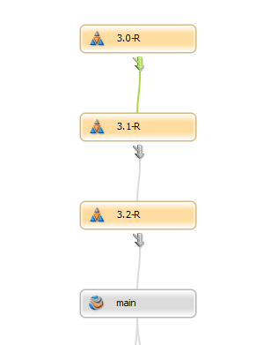
Basic Maintenance (Streams)
Note the older-to-newer flow. Streams communicates the change in flow.

Slide 14
Advanced Maintenance
//fgs/rel/8.0-R/src/master.c#59
//fgs/rel/8.0-R/src/hi.c#29
8.0.2
rel/8.0-R
8.0.0
8.0.1
8.0.3
rel/8.0-D
Sample Emergency Bug Fix Criteria:
It is time-critical andcan’t wait for the next standard patch.
The entire code/build/test/push cycle will take 48 hours or less.
Litmus Test: If you’re willing to wake up a VP at 2AM, it qualifies.
Warning: AVOID Abusing EBF! If abused, the ability to make real emergency fixes diminshes, since the *-R won’t accurately match code used to ship the last patch.
//fgs/rel/8.0-D/src/master.c#8
//fgs/rel/8.0-D/src/hi.c#2
/main
8.0
//fgs/main/src/master.c#59
//fgs/main/src/hi.c#29
Notes:
Discussion Points:
This strategy allows separation of “latest development” (rel/8.0-D) with “latest delivered” (rel/8.0-R) code within the 8.0 branch
Normal changes to support 8.0 are initiated in 8.0-D. After testing and perhaps at regular intervals, changes from 8.0-D are promoted to 8.0-R in discreet batches.
Emergency Bug Fixes are initiated directly in the 8.0-R branch, so that the critical bug fix can be implemented without worrying about the state of other changes in the 8.0-D branch, which could be in a “car apart in the garage” state. After the critical situation is dealt with, the emergency fix is refreshed from 8.0-R to 8.0-D, so that it is not removed the next promotion from 8.0-D to 8.0-R.

Slide 15
Patch Maintenance
//fgs/rel/8.0.03-P/src/master.c#1
//fgs/rel/8.0-03-P/src/hi.c#2
8.0.01
rel/8.0.01-P
rel/8.0.02-P
rel/8.0.03-P
8.0.03
8.0.02
8.0.0 (GA)
rel/8.0-R
//fgs/rel/8.0-R/src/master.c#3
//fgs/rel/8.0-R/src/hi.c#2
/main
8.0
//fgs/main/src/master.c#59
//fgs/main/src/hi.c#29

Slide 16
Basic Planned Development
rel/3.1-R
3.1.0
3.1.1
3.1.2
rel/3.2-R
3.0
“Sharable Quality”
To Do for 3.2:
Add support for Java/C++ Bridge.
Correct performance issue (BUG429)
Fix off-by-one index error.
Add DHTML output format.
Fix exit codes in test drivers.
To Do for 4.0:
Allow 1:1 and 1:n mappings in cfg files.
Fix “Black Screen of Death” (BUG994)
Provide Optimized/Debug options.
Add limited SQL interface via API.
Fix exit codes in test drivers.
QA Pass
/main
To Do for 3.1:
New Feature 304: Add ‘Goodbye’ messages.
Deprecate Windows-specific API calls.
Support XML-style config file input.
Add HTML output format.
Add call to test driver stubs in makefile.
QA Pass
dev/3.1
dev/4.0
dev/3.2
Notes:
Key Ideas:
Prevention a copy up before a merge down is a solid best practice.
Streams makes this almost impossible to get wrong.
With Classic Perforce, ensuring merge down is done is often done by automating the ‘copy up’, and building safety checks into the automation.

Slide 17
Merge Down, Copy Up
Part 1: Merge Down
Merge files changed in one branch with corresponding files in other branches.
Moves changes “down,” from more firm to less firm branch.
Uses 'p4 merge' and 'p4 merge' commands.
Requires potentially complex merge work, and sometimes manual conflict resolution.
Perforce helps greatly to simplify this complex process.
Notes:
xxx

Slide 18
Merge Down, Copy Up
Part 1: Merge Down (Continued)
Can introduce instability in the target, less.
Best done by someone intimately familiar with:
  The software and coding language,
  Requirements for the change,
  Insight to the history of changes, and
  Awareness of business and technical drivers for those changes.
Is often done as a piecemeal operation, e.g. by subsystem or areas of subject matter expertise, or areas of code ownership/responsibility.
Notes:
xxx

Slide 19
Merge Down, Copy Up
Part 2: Copy Up (aka “Promotion”)
Promotes exact copies of tested, trusted files to the next higher level.
Is an integration from a less stable to a more stable branch.
Requires no resolve (as it is a simple copy).
Uses the 'p4 copy' command.
Can be performed as a wholesale operation by a centralized Configuration Management or Release Engineering team.

Slide 20
Merge Down, Copy Up
Merge Down before Copy Up
Or, Pull before Push
Notes:
For Git users, this is similar to the “pull before you push” rule.

Slide 21
Selective Promotion
Plan A: Strict Merge Down/Copy Up
Doesn’t rely on or trust human dependency knowledge.
Safe: Only fully tested configurations of files, latest or up to a point in time, are promoted.
Enforces a degree of process simplicity that can have collateral benefit.
Optimal when the used with narrow, modular architectures, and/or if human dependency awareness is low.

Slide 22
Selective Promotion
Plan B: Selective Promotion
Relies on and trusts human dependency knowledge.
Allows promotion of configurations of files that never existed together at the same time.
Best used when human awareness of technical dependencies is high.
Sometimes necessary, albeit risky, with monolithic code bases.

Slide 23
Selective Promotion
Anti-Patterns to Avoid!
Avoid selective promotion with overlapping files.
Avoid “Promote by Activity Status.”
  Distilling detailed code change data into activity status information is Good.
  Driving code promotion based on activity status sounds Good, but rarely works or scales well.

Slide 24
Dev -> Stabilization -> Maintenance
RC2
3.1.0 (GA)
3.1.1 (Patch)
RC1
rel/3.1-R
Stabilization
Maintenance
3.0
“Sharable Quality”
/main
Sample process and typical lifecycle phase transitions are illustrated here. While PDS is intended to promote best practices and good processes, it is not a Process Standard. Examples here are for illustration only.
3.1
dev/FGS34
Early Dev
Dev
Phases
Early Dev: Requirements in flux.
Dev: Requirements locked. Normal development.
Stabilization: Code complete, test coverage 85%, < 3 critical bugs, < 20 major.
GA: Code complete. Test coverage 100%. No known critical or major bugs. < 20 minor bugs.

Slide 25
Advanced Planned Development
To Do for Feature Set 9.x-Perf:
Make “Hello, World” display faster.
Fix I/O bottlenecks for large data sets on NTFS.
Overcome max file handle limitations on Windows.
Reduce default ‘sleep’ values in Mac/OSX Startup.
Reduce system startup delays; get boot time to 45s.
Advanced Planned Releases:
Just as OO encourages design before coding, APD encourages planning before coding.
When planning, group feature sets with considerations like:
  Group together features that will heavily overlap code areas, based on technical requirements analysis by those familiar with system architecture.
  Give Feature Sets short tags that do not imply release order.
  Group features by categories such as:
    9.x-Perf: Performance improvements
    9.x-Enb: Enabling infrastructure (for future changes)
    9.x-Port: Platform ports
    9.x-Bld: Build system changes (no product functionality change)
    9.x-FSA: Required features for 9.x
    9.x-FSB: Optional feature for 9.x (may be retargeted)
    9.x-FSC: “Nice To Haves”
  Group together sets of features with similar business drivers, e.g. the same customer/sponsor.
9.0
9.1
9.2
/main
//fgs/main/…
To Do for Feature Set 9.x-Bld:
Add 64 bit support for Linux.
Add 1024 bit support for Cray XMP2020.
Standardize all makefiles on template compatible with Common Build System.
Add call to test driver stubs in makefiles.
int/9.x-I
//fgs/int/9.x-I/…
dev/9.x-FSA
To Do for Feature Set 9.x-FSA:
Implement “Undo” Feature in GUI.
Add undo_last() in CLI.
Add undo_last() server code.
Add undo_last() in API.
dev/9.x-Bld
dev/9.x-Perf
//fgs/dev/9.x-Perf/…

Slide 26
Customization
svcs/CustTag
//fgs/svcs/Navy/main/…
latest
//fgs/svcs/Navy/latest/…
3.1.0
rel/3.1-R
//fgs/rel/3.1-R/…
rel/3.2-R
//fgs/main/…
/main
3.1
3.2
Customization has begun.
Development delivers 3.2 to /main, and creates a generic product release branch for it.
Don’t forget – each generic product change made should be reviewed to determine if it needs to be integrated into the customization branch.
Sometimes, selective “cherry picking” integrations are performed when changes that originated as customizations are later deemed to be generic software product improvements or bug fixes.
Selective Promotions are used to integrate functionality from new releases to customization branches initially seeded with older releases.
Notes:
Talking Points:
Use short tags rather than company names in directory structures, to keep paths short and reduce confusion when customers’ company names change.
The “/main” and “/latest” within the svcs area may be maintained by a professional services organization.
This model supports truly custom code. It isn’t necessary if the customizations are just “skins” or minor per-customer configuration or license-file controlled variations.
Legal considerations may restrict cherry-picking integration of custom changes developed under a services contract.

Slide 27
Basic Hosted
live
//fgs/live/…
QA FAIL
QA Pass
QA Pass
/main
//fgs/main/…
Good for:
Relatively stable/inactive hosted apps supported by very small teams.

Slide 28
Standard Hosted
live
//fgs/live/…
QA FAIL
//fgs/main/…
QA Pass
QA Pass
/main
latest
//fgs/dev/latest/…
Good for:
Hosted apps supported by larger teams.
Relatively stable/inactive apps, OR active apps where individual contributors have little or no overlap in terms of affected files.
Apps that work on one release at a time.

Slide 29
Standard Hosted w/EBF
live
//fgs/live/…
QA Pass
QA Pass
/main
//fgs/main/…
latest
//fgs/dev/latest/…
Good for:
Hosted apps supported by larger teams.
Relatively stable/inactive apps, OR active apps where individual contributors have little or no overlap in terms of affected files.
Apps that work on one release at a time.
Apps with potential for urgent/critical bug fixes.

Slide 30

Advanced Best Practice:
Auto Merge
8.5-R (Patch Branch)
9.0-R (Patch Branch)
MAIN
8.5
9.0
Human Change
Automerge
Features:
Frequent merging reduces merge complexity, often even for manual merges.
Preserves original human author through merge flow.
Reminder and Active modes.
Auto-merging is an advanced practice; it requires custom automation.
Notes:
See Newsletter article on Auto Merging: http://www.perforce.com/company/newsletter/2009/10/technofiles-living-edge-automated-merging
Key Ideas:
Incremental Merging (one changelist at a time, in original time order, along a defined merge pathway).
Preserves original human changelist author throughout the merge flow.
Frequent merging reduces merge complexity, so only the individual changes requiring manual resolution must be handled manually.
Requires custom automation.

Slide 31
Static PDS Samples
Static slides for review and discussion
Notes:
Static slides are provided so you can quickly jump to a slide for discussion, without having to go through the animations.

Slide 32
Organic Development
//fgs/main/src/main.c#7
//fgs/main/src/hello.c#4
//fgs/main/src/makefile#18
//fgs/main/src/api/hello.h#4
//fgs/main/etc/greetings.cfg#4
//fgs/main/etc/skins.cfg#124
3.0
3.1
3.2
4.0
/main
Dev
Dev
Test
Test

Slide 33

Organic Development (Streams)

Slide 34
Basic Maintenance
rel/4.0-R
4.0.0
4.0.1
4.0.2
4.0.3
rel/4.1-R
4.1.0
4.1.1
rel/5.0-R
4.0
4.1
5.0
/main

Slide 35
Basic Maintenance (Streams)
Note the older-to-newer flow. Streams communicates the change in flow.

Slide 36
Advanced Maintenance
8.0.2
rel/8.0-R
8.0.0
8.0.1
8.0.3
rel/8.0-D
/main
8.0

Slide 37
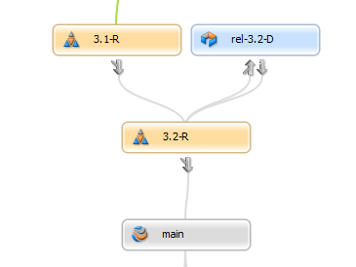
Advanced Maintenance (Streams)

Slide 38
Patch Maintenance
8.0.01
rel/8.0.01-P
rel/8.0.02-P
rel/8.0.03-P
8.0.03
8.0.02
8.0.0 (GA)
rel/8.0-R
/main
8.0
Notes:
The “.01” is just an example of typical variations on how a PDS may look. A PDS should define acceptable variations.

Slide 39
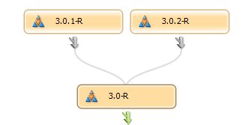
Patch Maintenance
(Streams)
Notes:
The “.01” is just an example of typical variations on how a PDS may look. A PDS should define acceptable variations.

Slide 40
Basic Planned Development
rel/3.1-R
3.1.0
3.1.1
3.1.2
rel/3.2-R
3.0
“Sharable Quality”
/main
dev/3.1
dev/4.0
dev/3.2

Slide 41
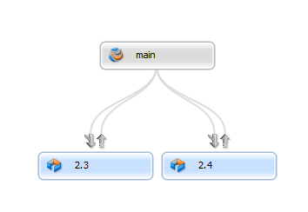
Basic Planned Development (Streams)

Slide 42
Advanced Planned Development
9.0
9.1
9.2
/main
//fgs/main/…
int/9.x-I
//fgs/int/9.x-I/…
dev/9.x-FSA
dev/9.x-Bld
dev/9.x-Perf
//fgs/dev/9.x-Perf/…

Slide 43
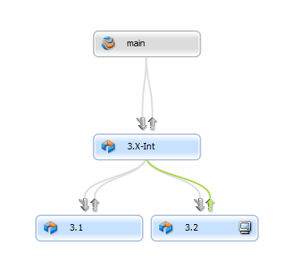
Advanced Planned Development (Streams)

Slide 44
Customization
svcs/CustTag
//fgs/svcs/Navy/main/…
latest
3.1.0
rel/3.1-R
//fgs/rel/3.1-R/…
rel/3.2-R
//fgs/main/…
/main
3.1
3.2

Slide 45
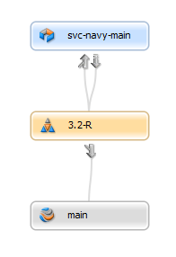
Customization (Streams)

Slide 46
Basic Hosted
live
//fgs/live/…
QA FAIL
QA Pass
QA Pass
/main
//fgs/main/…
Good for:
Relatively stable/inactive hosted apps supported by very small teams.

Slide 47
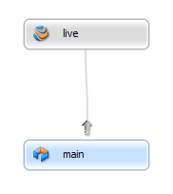
Basic Hosted (Streams)

Slide 48
Standard Hosted
live
//fgs/live/…
QA FAIL
//fgs/main/…
QA Pass
QA Pass
/main
latest
//fgs/dev/latest/…
Good for:
Hosted apps supported by larger teams.
Relatively stable/inactive apps, OR active apps where individual contributors have little or no overlap in terms of affected files.
Apps that work on one release at a time.

Slide 49
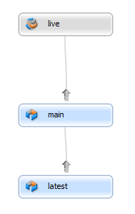
Standard Hosted (Streams)

Slide 50
Standard Hosted w/EBF
live
//fgs/live/…
QA Pass
QA Pass
/main
//fgs/main/…
latest
//fgs/dev/latest/…
Good for:
Hosted apps supported by larger teams.
Relatively stable/inactive apps, OR active apps where individual contributors have little or no overlap in terms of affected files.
Apps that work on one release at a time.
Apps with potential for urgent/critical bug fixes.

Slide 51
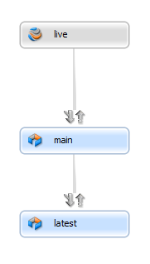
Standard Hosted w/EBF (Streams)
Enable merge downs

Slide 52
Questions?

